Slide 2
A journey with XP – Case study

Slide 3
Why we needed XP practices
Lots of problems got exposed through agile practises

Slide 4
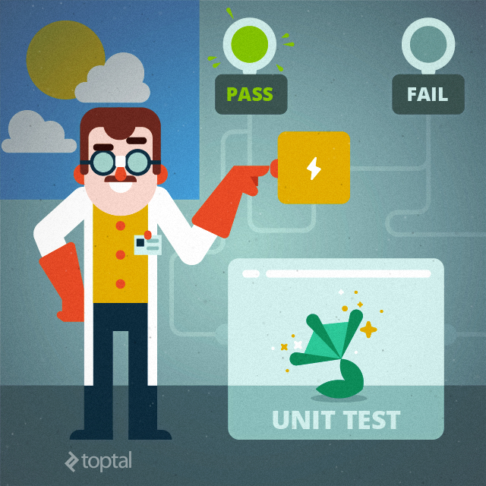
Problems
All unit tests passing-All the time
At the same time defects also got passed

Slide 5

Problems
Automate every test at the System Level
Automation was a big head ache

Slide 6


Problems
Big sized user stories
Teams situation

Slide 7
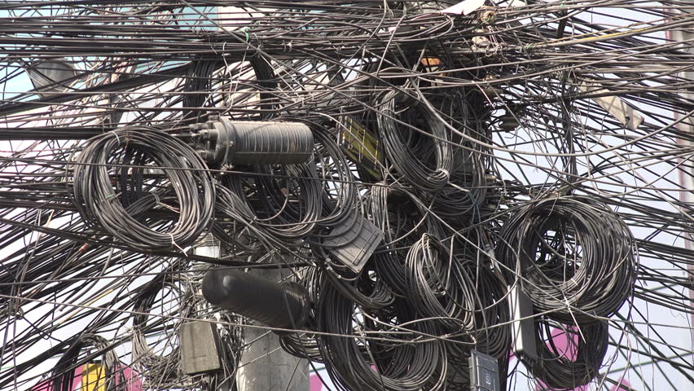
Problems
CI infrastructure
Other problems…..
Long debugging cycles
Multilayered architecture
Legacy Code
Always spill overs

Slide 8
What we had
1. Scrum teams
2. Leadership teams
3. An infra structure for CI
4. Unit tests and integration tests
5. Agile trainings

Slide 9

First trial of our journey
Created a team of champions, from various projects
Trainings on XP practices with live code
Put them back to their projects

Slide 10

Result after 4 sprints
Leadership focused on deliveries
Not Interested in Engineering practices
Objectives of project change
No support to champions
Escalations
Champions searched other jobs
Don’t know how to do bla bla bla

Slide 11

Second trial of our journey
Identified a target project (Eligible for transformation )
Leader ship team and customer was educated
3 targeted scrum teams
Sprint based goals
Inspect and adapt methods

Slide 12

Then came our way
Not deviating much from the existing work flow, tools and technology
A big heap of legacy code
How to write Unit tests?
Multilayered architecture- where to stop? Where to start?
Different technologies in each layer
No test frame works in few components
Very few experts in all the areas
People mind set

Slide 13
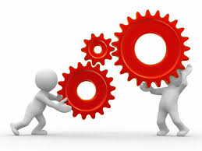
What’s next?
Organize teams based on features and experience
Workshops
Backlog with simpler user stories (Across the layers)
Explore new technologies to fill up gap
Brain storm on handling multi layered, multi component based architecture (Aligning tools, frame work, technologies etc )

Slide 14
On the court
Vertical way of tasking
Deriving BDD scenarios
Identify the impacted layers
Deriving test pyramid
Using existing tools and technologies in a different way
Unit tests and its importance
Integration tests
Controlled coding

Slide 15

After 4 sprints
Less spill overs
Sense of accomplishment
Easy way of automating tests
Easy debugging
Easy integration tests
No transferring defects

Slide 16
Results (10 sprints)
Team is self driven
New champions
Targeted team were 3, infected team were 6
Started TDD
Pair programming
New experiments
One complete feature was delivered with Zero P1 defects

Slide 17
What did not go well
On the second engagement….
Partnering customer
Partnering higher management
As an opportunity to the team
Sustainability
We put a logical end after 6 sprints

Slide 18
Where are we now
One account with 9 Scrum teams is on XP (70 people )
One more account with 6 scrum teams is in the path of break through(40 people )
Third account with 7 scrum teams is not fully transformed (56 people )
15 senior contributors infected by XP

Slide 19
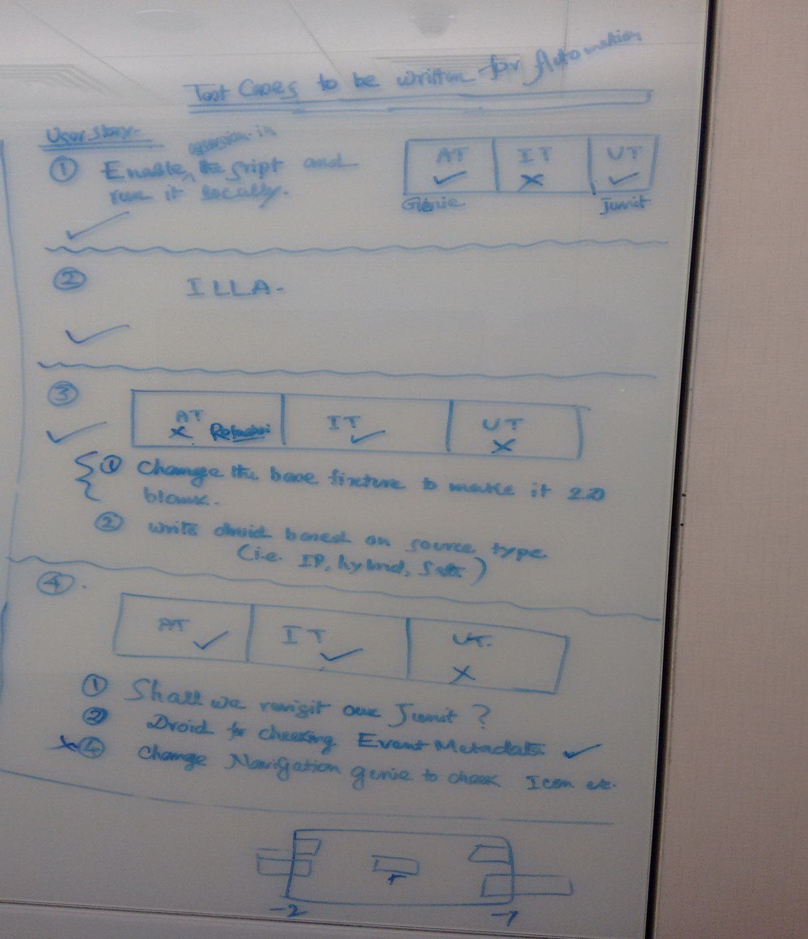
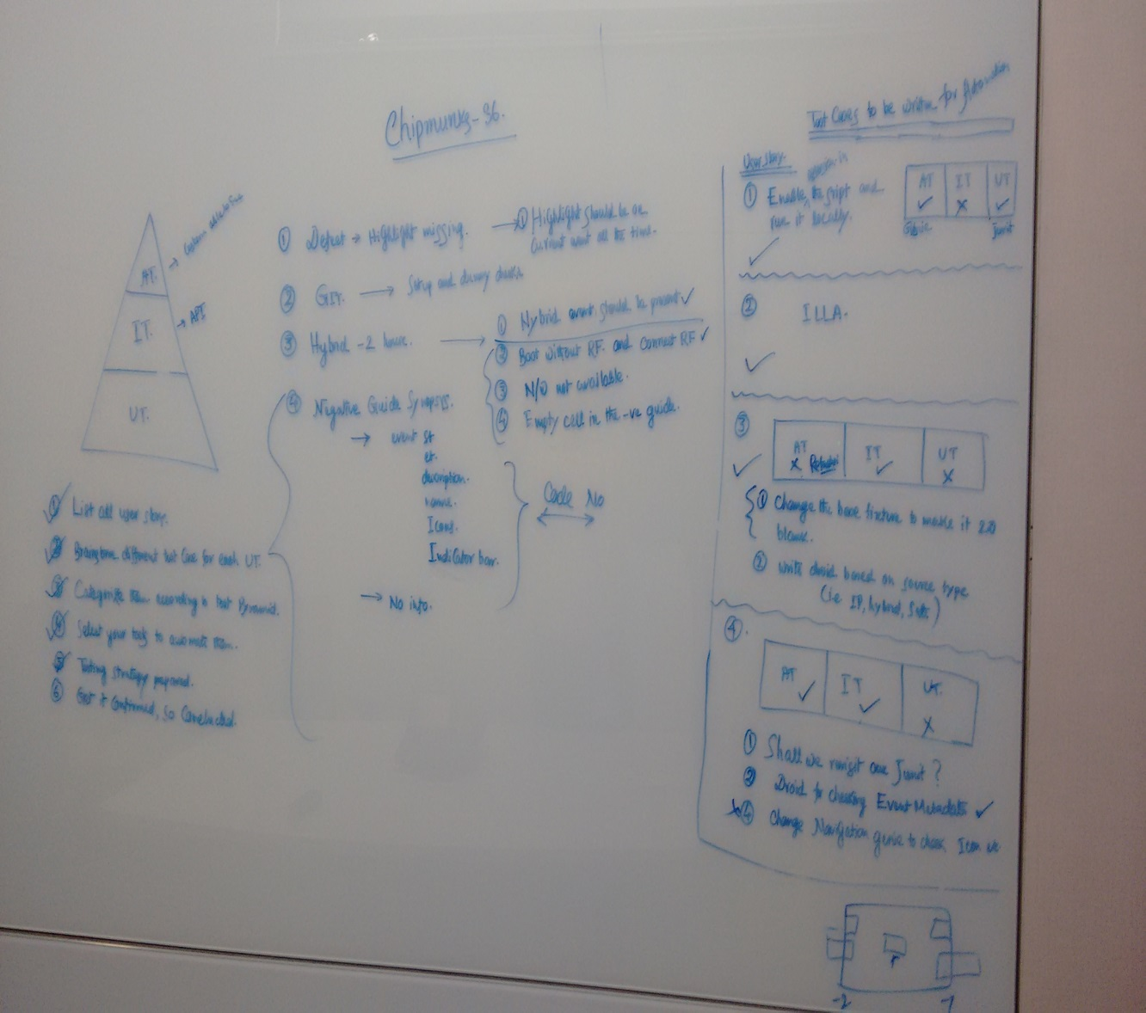
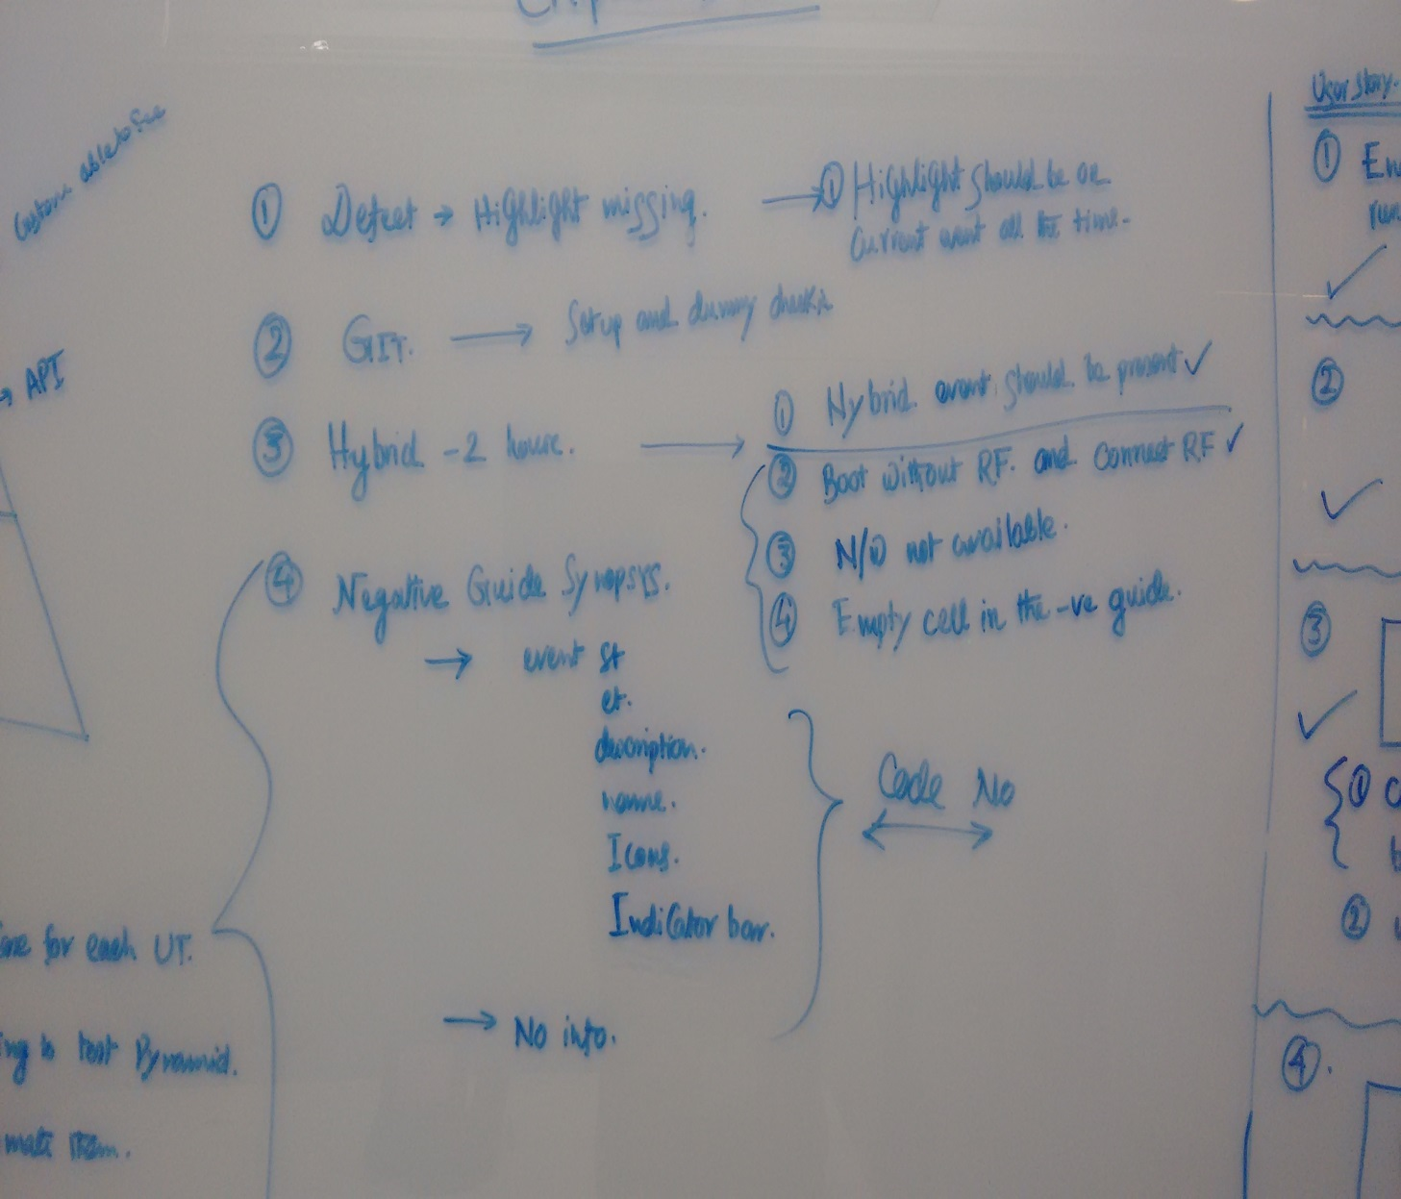
Signatures

Slide 20
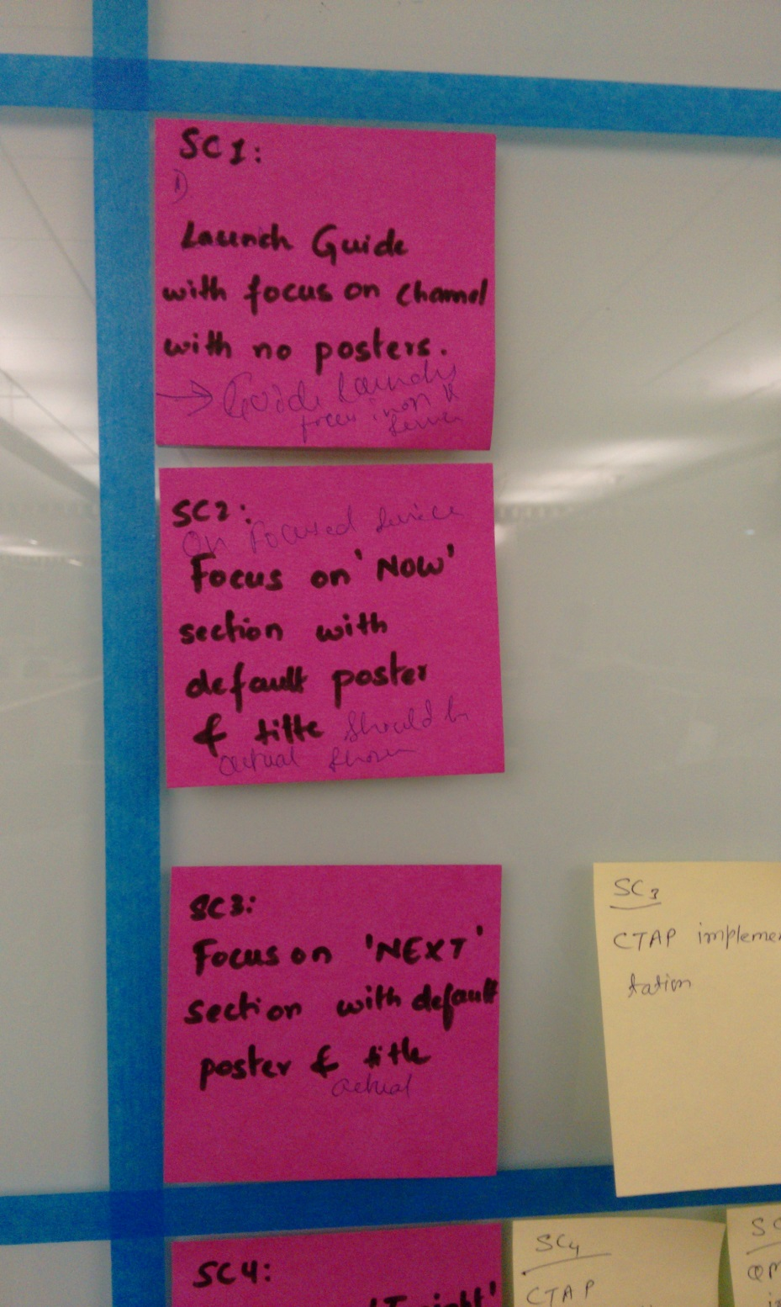
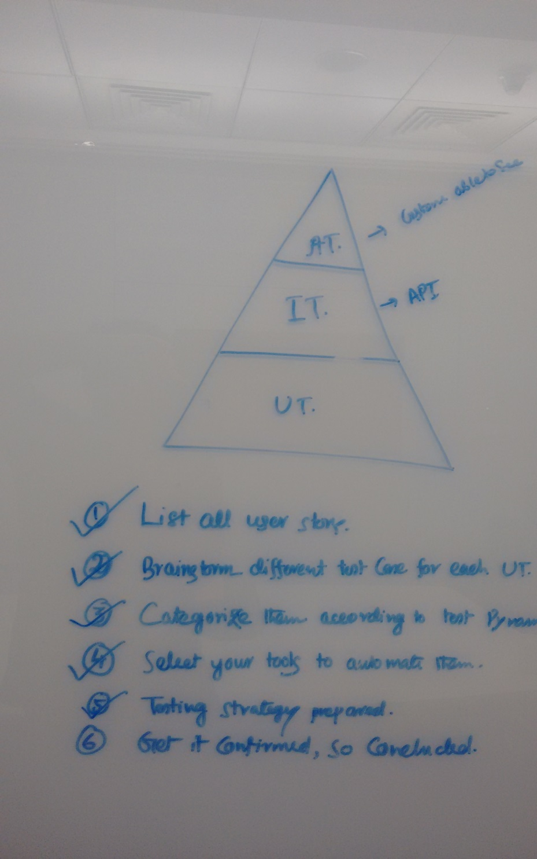
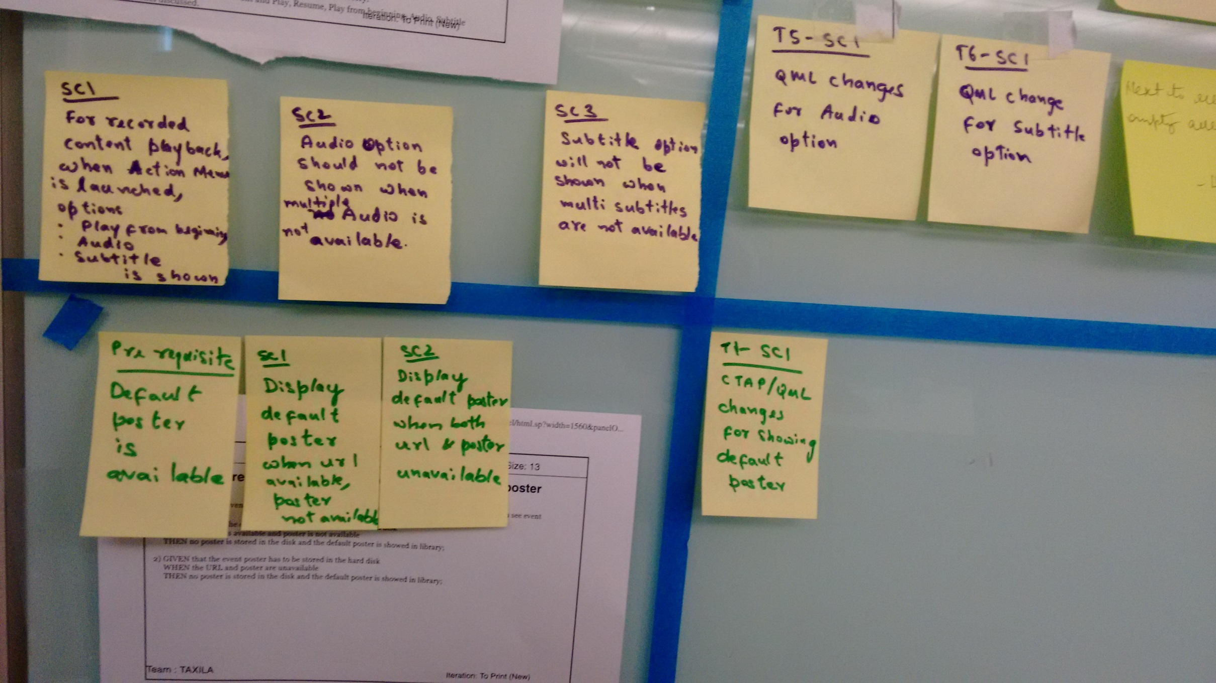
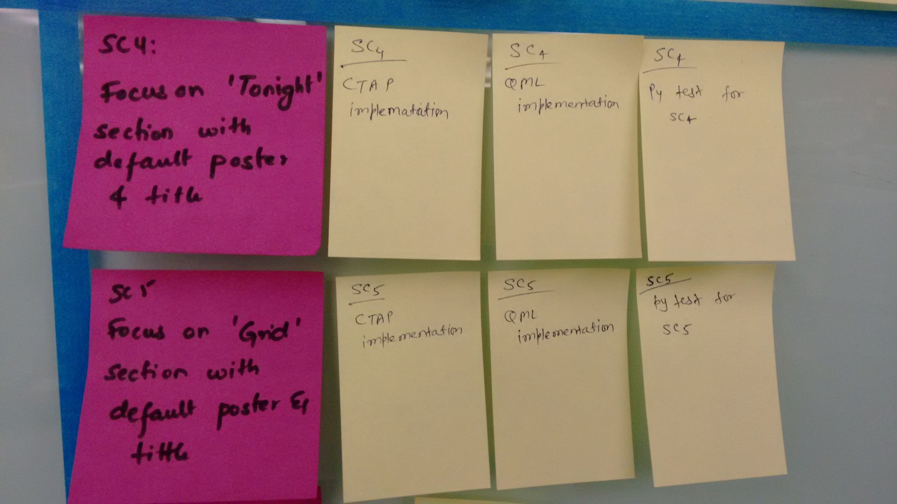
Signatures

Slide 21
Questions
I will try to answer from my experience ☺

